Slide 1


Slide 2
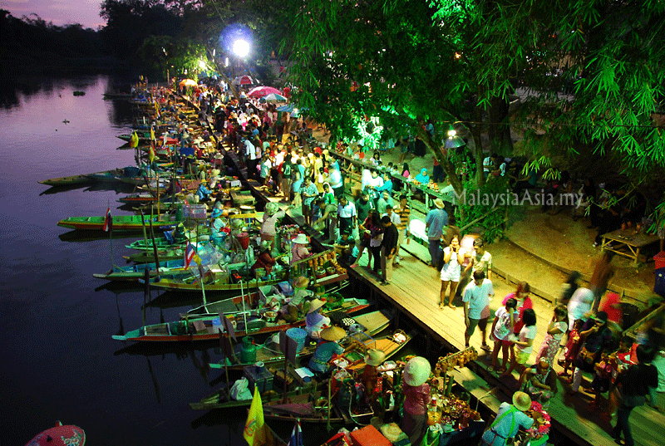
Teacher introducing
Md. Mizanur Rahman
Assistant teacher (English)
Gopalpur M.L. Secondary School
Manirampur, Jessore
Email: MizaRahtec@gmail.com
Mobil: 01912-214182

Slide 3
Class introducing
Class : Six
Subject : English 1st paper
Topics : Floating Market
Time : 40 Minutes

Slide 4
Learning outcome
By the end of this lesson the learners-
Will be able to ask and answer the questions
Will be able to write a suitable word in each gap
Will be able to learn new word

Slide 5
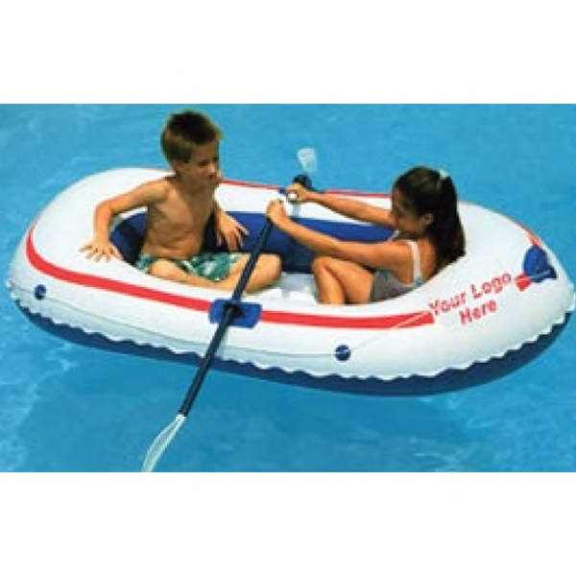
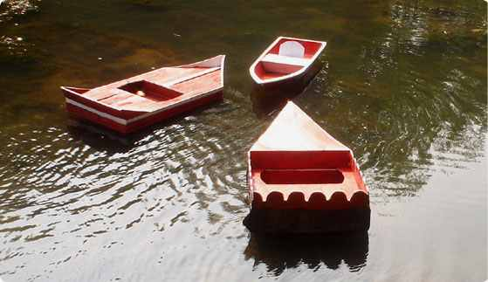

Floating

Slide 6
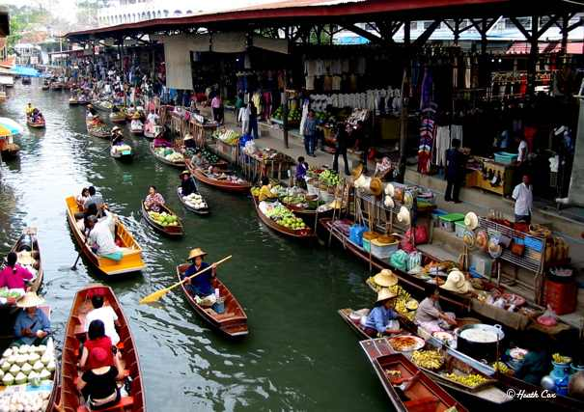
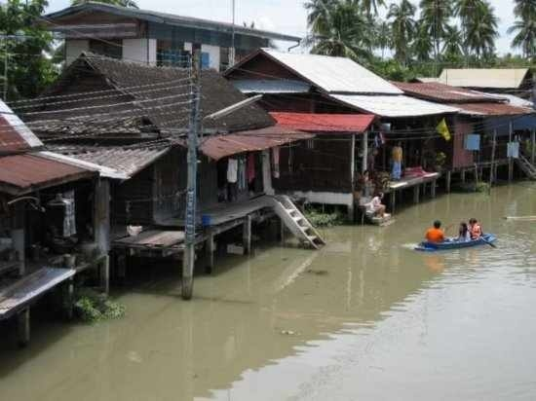
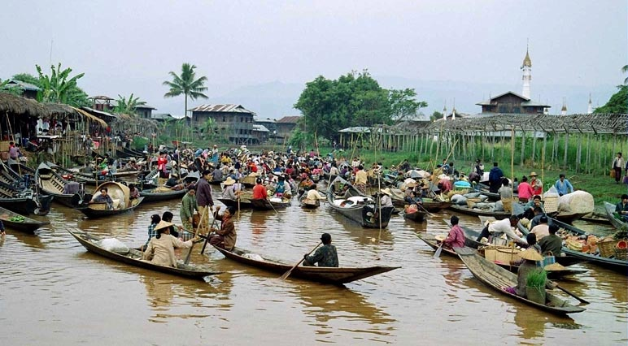

Slide 7

Unit-8, Lesson-10, Page no – 101

Slide 8
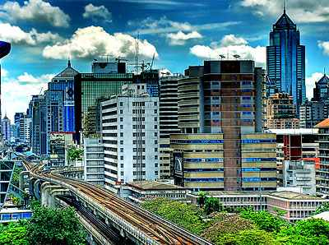
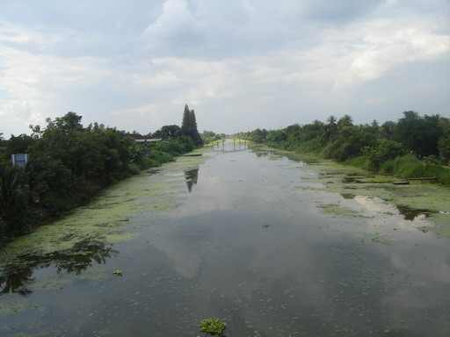
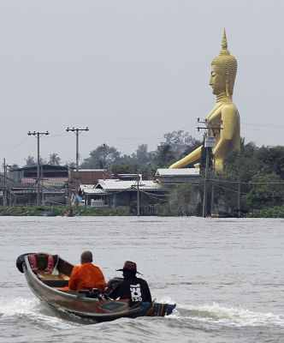
Vocabulary
canal
Visit
town
Travel
city
Klongs
Sentence
There are many Klongs in Bangkok
They always travelled by boat
Bangkok is a large noisy city

Slide 9
Our text here
Open your book (Unit-8, Lesson-10, Page no – 101)
Read the passage (10mins)

Slide 10
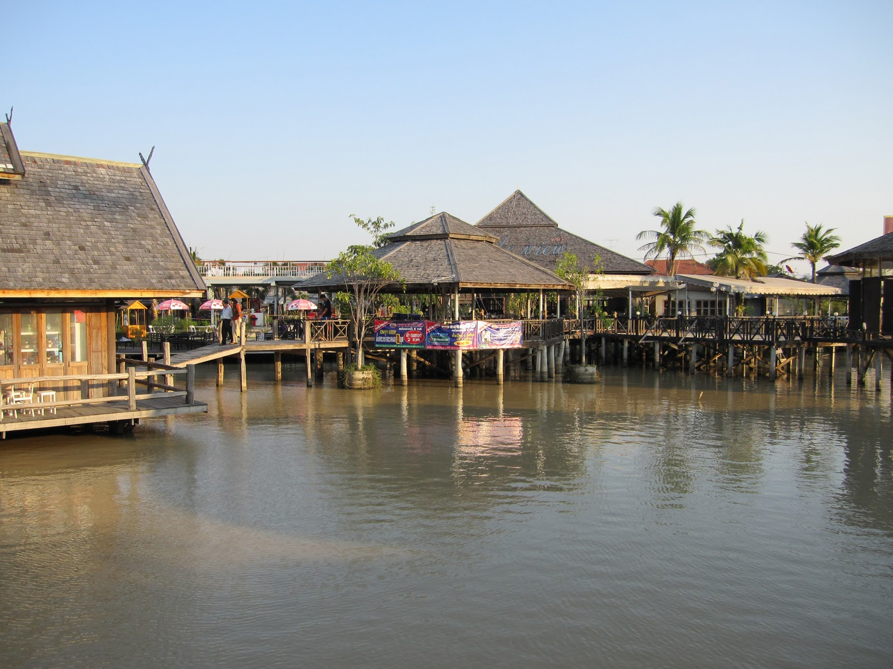
Click on Video
http://www.youtube.com/watch?v=lw3EzKuvM3A

Slide 11
B.(Group work-6mins) Write your answer in your exercise books (text book section-B)

Slide 12
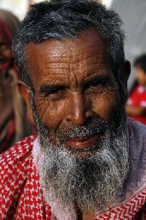
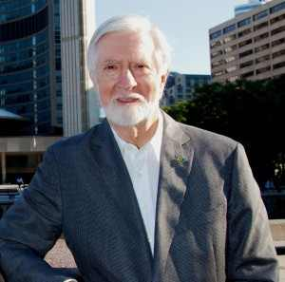
Look at the pictures
C. (Pair work -5mins) Write a suitable word in each gap: (Text book Section c)

Slide 13
Evaluation
Sabina’s grandfather has visited Thailand.
There are many ------ in Bangkok.
Where does Niran’s family live in Bankgkok?

Slide 14

Homework
You will write a paragraph on “The floating Market”

Slide 15


